Slide 1
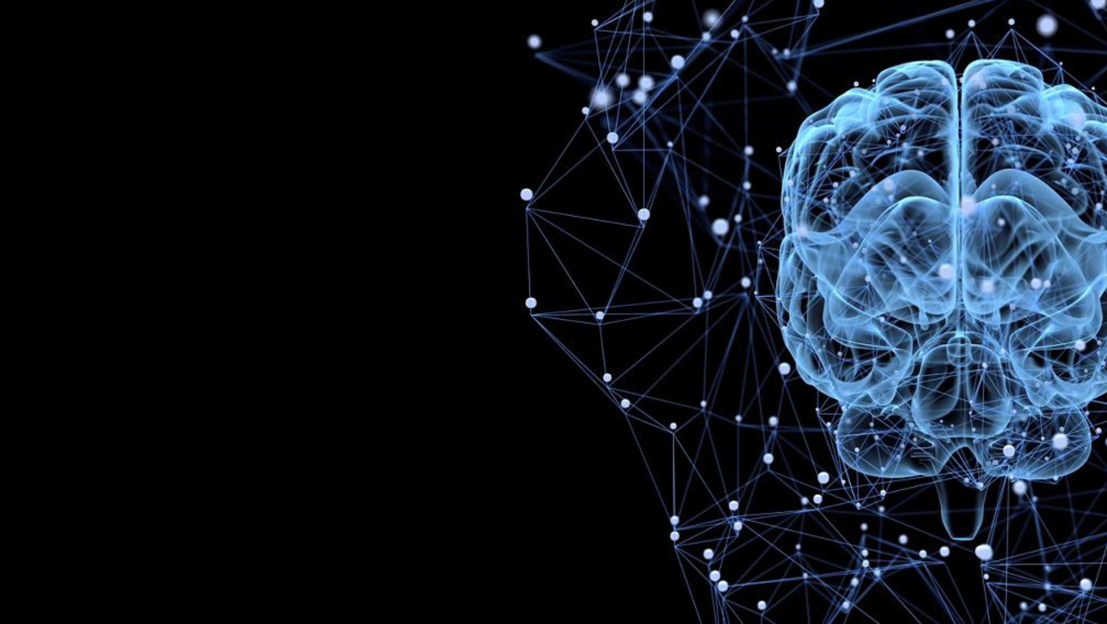

NLP

Slide 2

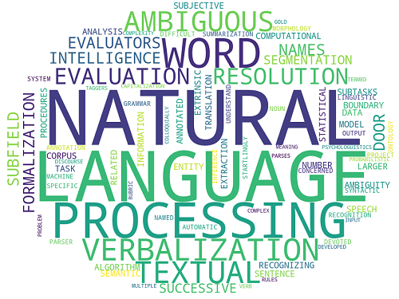

Slide 3

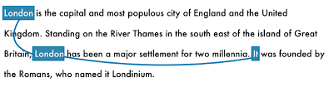
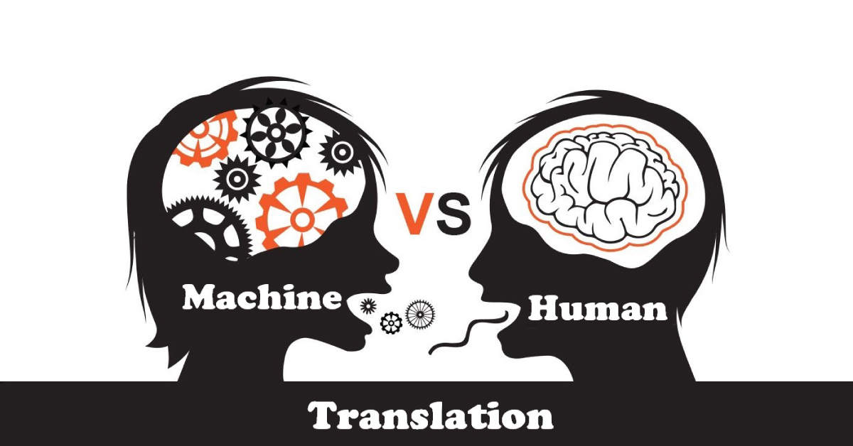

Что такое NLP?
Named Entity Recognition
Machine translation
Text classification

Slide 4

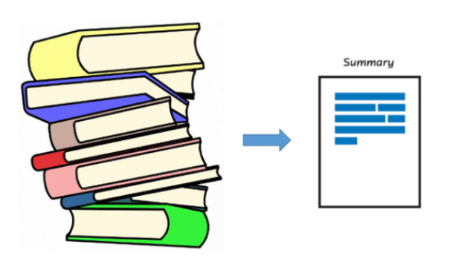
ЧТО ТАКОЕ
NLP
Chat-bot
Text summarization

Slide 5
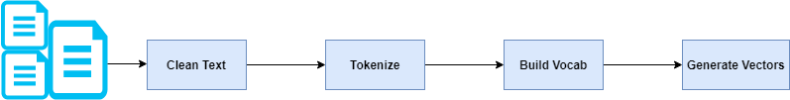
Pipeline
NLP

Slide 6
Приведение к нижнему регистру
Очистка/обработка специальных символов/слов
Удаление СТОП-слов
Токенизация
Лемматизация/Стемминг
Pipeline NLP
Text
preprocessing

Slide 7
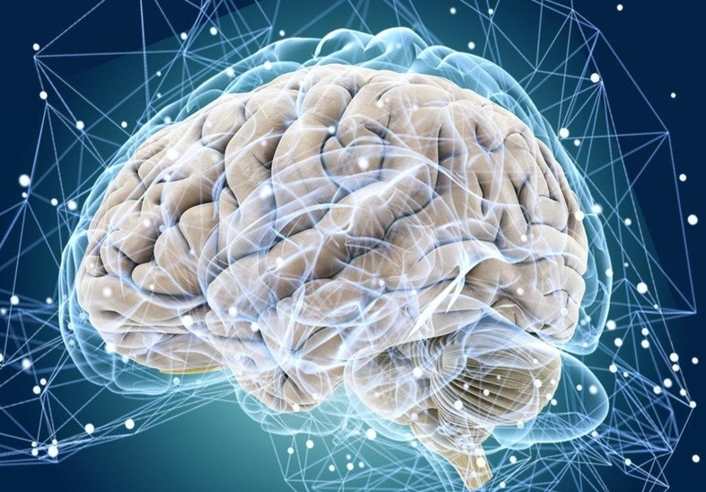

NLP
Example text preprocessing:
convert text to lowercase
Python code:
input_str = ”The 5 biggest countries by population in 2017 are China, India, United States, Indonesia, and Brazil.” input_str = input_str.lower() print(input_str)
Output:
the 5 biggest countries by population in 2017 are china, india, united states, indonesia, and brazil.

Slide 8
NLP
Example text preprocessing:
remove numbers
Python code:
import re
input_str = “Box A contains 3 red and 5 white balls, while Box B contains 4 red and 2 blue balls.” result = re.sub(r’\d+’, ‘’, input_str) print(result)
Output:
Box A contains red and white balls, while Box B contains red and blue balls.

Slide 9
NLP
Example text preprocessing: remove punctuation
Python code:
import re
input_str = 'This &is [an] example? {of} string. with.? punctuation!!!!' # Sample string
output_str = re.sub(r"[!”#$%&’()*+,-./:;<=>?@[\]^_`{|}~]", ’’”, input_str)
print(output_str)
Output:
This is an example of string with punctuation

Slide 10
NLP
Example text preprocessing: stop
words removal and tokenization
Python code:
input_str = “NLTK is a leading platform for building Python programs to work with human language data.” stop_words = set(stopwords.words(‘english’))
from nltk.tokenize import word_tokenize tokens = word_tokenize(input_str) result = [i for i in tokens if not i in stop_words] print (result)
Output:
[‘NLTK’, ‘leading’, ‘platform’, ‘building’, ‘Python’, ‘programs’, ‘work’, ‘human’, ‘language’, ‘data’, ‘.’]

Slide 11



NLP
Python code:
from nltk.tokenize import word_tokenize
input_str = ” @john lol that was #awesome :)” word_tokenize(input_str)
Tokenizers
Python NLTK | nltk.tokenize.LineTokenizer
Python NLTK | nltk.tokenize.SExprTokenizer()
Python NLTK | nltk.tokenize.TabTokenizer()
Python NLTK | nltk.tokenize.StanfordTokenizer()
Python NLTK | nltk.tokenize.SpaceTokenizer()
Python | NLTK nltk.tokenize.ConditionalFreqDist()
Python NLTK | nltk.tokenize.mwe()
Python NLTK | tokenize.WordPunctTokenizer()
Python NLTK | tokenize.regexp()
Python | Tokenize text using TextBlob
Python NLTK | nltk.tokenizer.word_tokenize()
Python NLTK | nltk.WhitespaceTokenizer
Python NLTK | nltk.TweetTokenizer()
Python | Lemmatization with NLTK
Python | Stemming words with NLTK
Output:
['@', 'john', 'lol', 'that', 'was', '#', 'awesome', ':', ')']
Python code:
from nltk.tokenize import TweetTokenizer
tokenizer = TweetTokenizer()
tokenizer.tokenize(mytweet)
Output:
['@john', 'lol', 'that', 'was', '#awesome', ':)']

Slide 12
NLP
Normalization of words
Simple examples:
books — book,
looked — look
Stemming
Lemmatization
Complex examples:
have - had,
do — did,
bring – brought,
catch - caught

Slide 13
NLP. Stemming
Stemmers:
nltk.stem.PorterStemmer()
nltk.stem.SnowballStemmer('english’)
nltk.stem.lancaster.LancasterStemmer()
https://www.nltk.org/api/nltk.stem.html
Porter stemming algorithm
Snowball stemming algorithm
Lancaster stemming algorithm
Python code:
from nltk.stem import PorterStemmer from nltk.tokenize import word_tokenize stemmer= PorterStemmer() input_str=”There are several types of stemming algorithms.” input_str=word_tokenize(input_str) for word in input_str: print(stemmer.stem(word))
Output:
There are sever type of stem algorithm.

Slide 14

NLP
Python code:
from nltk.stem import WordNetLemmatizer from nltk.tokenize import word_tokenize lemmatizer=WordNetLemmatizer() input_str=”been had done languages cities mice” input_str=word_tokenize(input_str) for word in input_str: print(lemmatizer.lemmatize(word))
Lemmatization
NLTK (WordNet Lemmatizer),
spaCy,
TextBlob Pattern,
gensim,
Stanford CoreNLP
Output:
be have do language city mouse

Slide 15

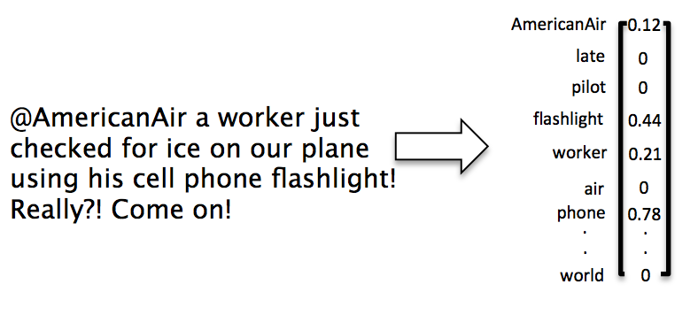
NLP
Numeric representations
Bag of words (BOW)
TF-IDF

Slide 16
NLP
Bag of words
Corpus:
"John likes to watch movies. Mary likes movies too.”
"John also likes to watch football games."
Corpus after remove punctuation and tokenization:
['John', 'likes', 'to', 'watch', 'movies', 'Mary', 'likes', 'movies', 'too’]
['John', 'also', 'likes', 'to', 'watch', 'football', 'games']

Slide 17
NLP
Bag of words
Count words in texts:
{"John":1,"likes":2,"to":1,"watch":1,"movies":2,"Mary":1,"too":1}
{"John":1,"also":1,"likes":1,"to":1,"watch":1,"football":1, "games":1}
Vocabulary:
{"John":2,"likes":3,"to":2,"watch":2,"movies":2,"Mary":1, "too":1,"also":1,"football":1,"games":1}
Vocabulary size is 11 = length of vectors!

Slide 18


NLP
Bag of words
John likes to watch movies. Mary likes movies too.
[1, 2, 1, 1, 2, 1, 1, 0, 0, 0]
John also likes to watch football games.
[1, 1, 1, 1, 0, 0, 0, 1, 1, 1]
Corpus:
[1, 2, 1, 1, 2, 1, 1, 0, 0, 0]
[1, 1, 1, 1, 0, 0, 0, 1, 1, 1]

Slide 19
NLP
TF - IDF
Corpus:
"John likes machine learning and mathematic. "
"Mary likes mathematic and physics."
Corpus after remove punctuation and tokenization:
['John', 'likes', ' machine ', 'learning', ‘and’, ' 'mathematic']
[Mary ', likes ', 'mathematic', ‘and’, ' physics ']

Slide 20
NLP
TF - IDF
Count words in texts:
{"John":1,"likes":1,”machine":1,”learning":1,”and":1," mathematic ":1}
{" Mary ":1,"likes":1,”, " mathematic ":1,”and":1, " physics ":1}
Vocabulary:
{"John":1,"likes":2," machine ":1," learning ":1,”and":2," mathematic ":2, " Mary ":1," physics ":1}
Vocabulary size is 8 = length of vectors!

Slide 21
NLP
TF - IDF
TF-IDF = Term Frequency (TF) * Inverse Document Frequency (IDF)
t — term (word)
d — document (set of words)
N — count of corpus
corpus — the total document set
Term Frequency
tf(t,d) = count of t in d / number of words in d
Document Frequency
Inverse Document Frequency
df(t) = occurrence of t in documents
idf(t) = N/df

Slide 22
NLP
TF - IDF
Term Frequency
tf(t,d) = count of t in d / number of words in d
= 1/6
= 1/5
Inverse Document Frequency
idf(t) = N/df
{"John":2/1,"likes":2/2," machine ":2/1," learning ":2/1,”and":2/2," mathematic ":2/2, " Mary ":2/1," physics ":2/1}
Vocabulary:
N = 2
{"John":1,"likes":2," machine ":1," learning ":1,”and":2," mathematic ":2, " Mary ":1," physics ":1}

Slide 23
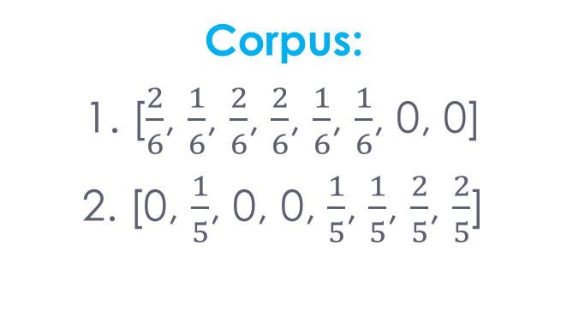
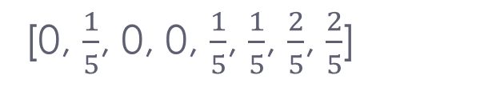
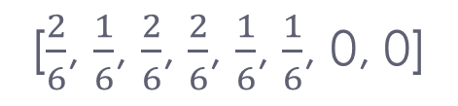
NLP
TF - IDF
"John likes machine learning and mathematic. "
[$\frac{2}{6}$, $\frac{1}{6}$, $\frac{2}{6}$, $\frac{2}{6}$, $\frac{1}{6}$, $\frac{1}{6}$, 0, 0]
"Mary likes mathematic and physics."
[0, $\frac{1}{5}$, 0, 0, $\frac{1}{5}$, $\frac{1}{5}$, $\frac{2}{5}$, $\frac{2}{5}$]
Corpus:
1. [$\frac{2}{6}$, $\frac{1}{6}$, $\frac{2}{6}$, $\frac{2}{6}$, $\frac{1}{6}$, $\frac{1}{6}$, 0, 0]
2. [0, $\frac{1}{5}$, 0, 0, $\frac{1}{5}$, $\frac{1}{5}$, $\frac{2}{5}$, $\frac{2}{5}$]

Slide 24
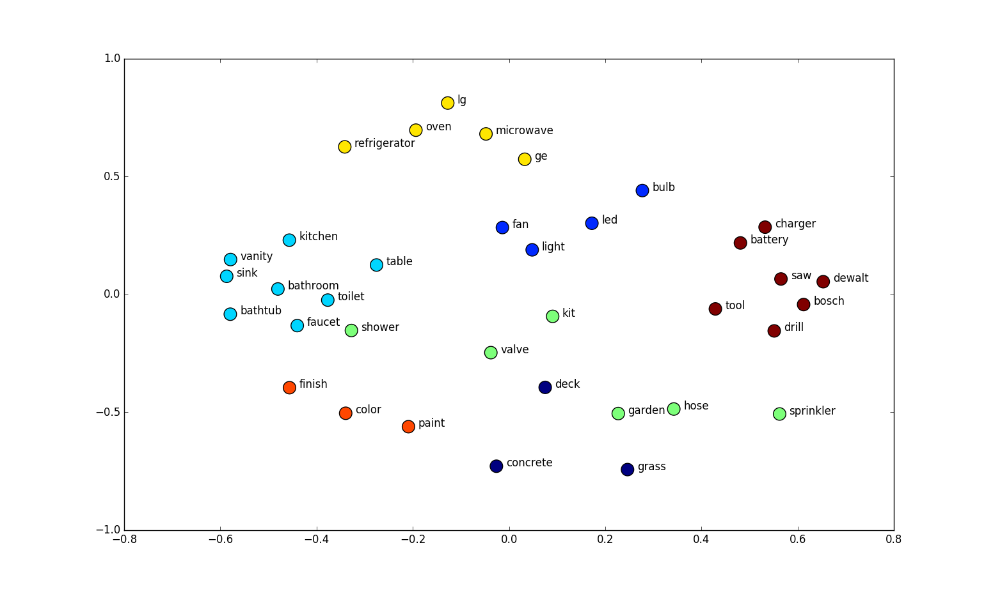
NLP
Word Embeddings
Word2Vec
Fasttext
Glove

Slide 25
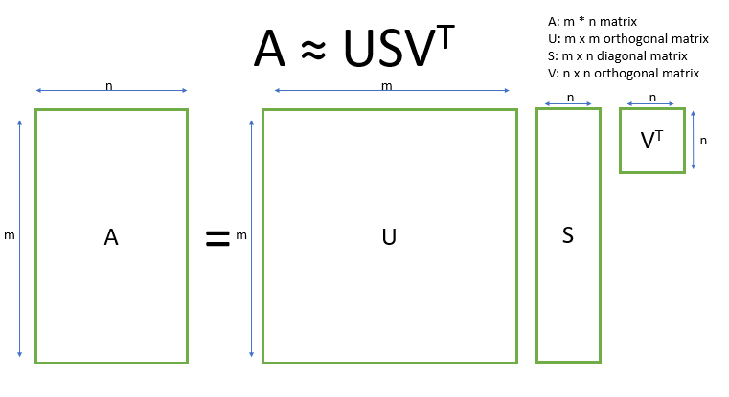
NLP
Dense vectors via SVD

Slide 26
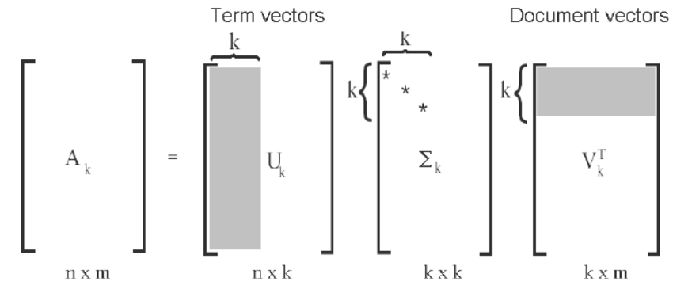
NLP
Dense vectors via SVD

